Slide 1
Mental Health and Suicide rate impacts worldwide
By Group 4
Rosie, Christian, Valeria

Slide 2
Overview Of Our Project
Why are we passionate about this topic?
In the last decade we’ve seen an increase in concern in the media about mental health from news, social media, TV and movies, and even in conversation.
Is mental health a new problem or was it just not publicized like it is now?
In our project we are looking to answer a few questions about suicide rate worldwide.
What do we want to know?
Are younger generations more susceptible to mental health and suicide?
Which sex is committing suicide at a higher rate worldwide?
Does a countries’ status have any effect on mental health
Does a country’s economy (GDP) affect suicide rates?
Over the years has suicide and mental health become a silent pandemic?
Capstone Project | Rutgers Bootcamp |Group 4|Rosie, Christian, Valeria| Non - Confidential

Slide 3
The Dataset Used
Since we decided to tackle the silent yet serious issue of mental health, we believed it was best to look for a dataset that can give us a broad world view and an understandable one.
The dataset we chose to incorporate into our analysis is the Suicide Rates Overview 1985 to 2016 uploaded by Rusty from Kaggle.com
This dataset gives first gives us a broad view on the topic by first pulling data across multiple countries worldwide with around 30 years worth of data!
In addition, this dataset also showed us many aspects of each country’s citizens who have committed suicide in hopes of inspiring suicide prevention.
Some of the aspect we will take a look at include:
Gender
Age
Socio Economic backgrounds, etc
Capstone Project | Rutgers Bootcamp |Group 4|Rosie, Christian, Valeria| Non - Confidential

Slide 4
Tools Used To Perform Our Analysis
The model we believed would fit best with our dataset is the Supervised Machine Learning Model.
We first noticed that the data we had found provided the labels we needed in order to predict possible future trends.
In order to best look for predictions, we believed using multiple algorithms (using Linear Regression and Decision Trees) can show us any substantial differences in accuracy our results may have produced.
The algorithms we found to be the best for our data include:
BalancedRandomForestClassifier
SMOTEEN
RandomOverSampler
We used Tableau in order to provide visualizations of the different correlations seen due to the many factors that can lead to suicide.
Capstone Project | Rutgers Bootcamp |Group 4|Rosie, Christian, Valeria| Non - Confidential

Slide 5
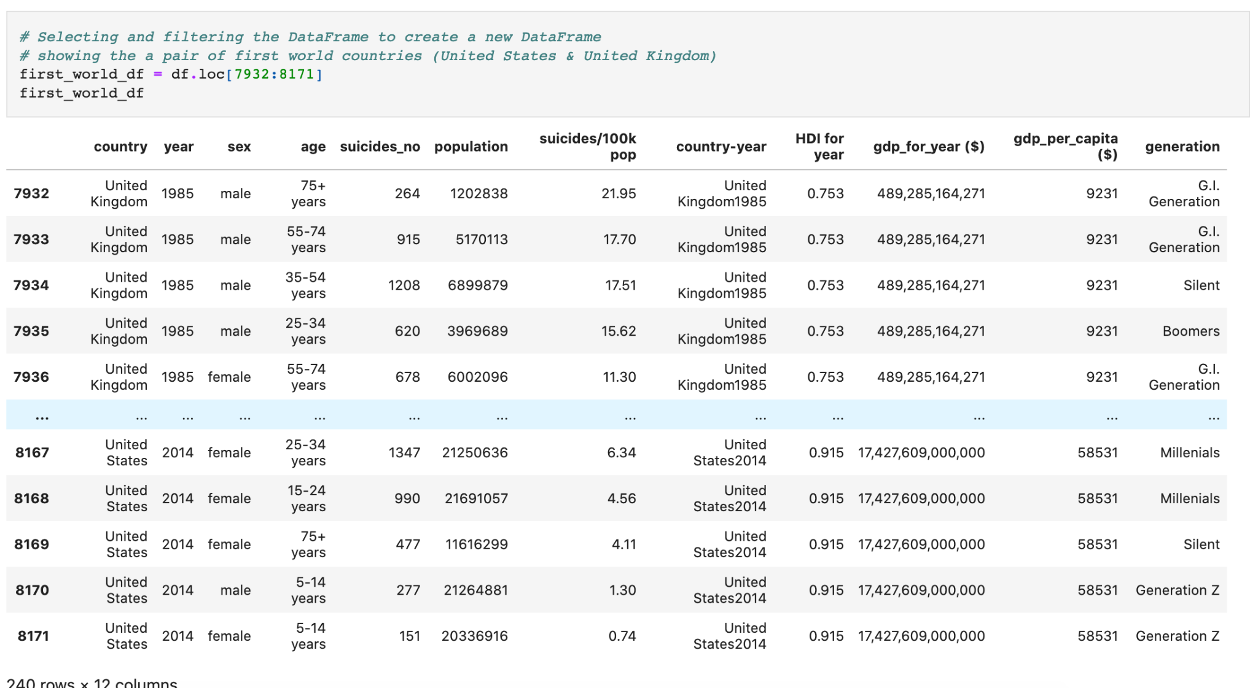
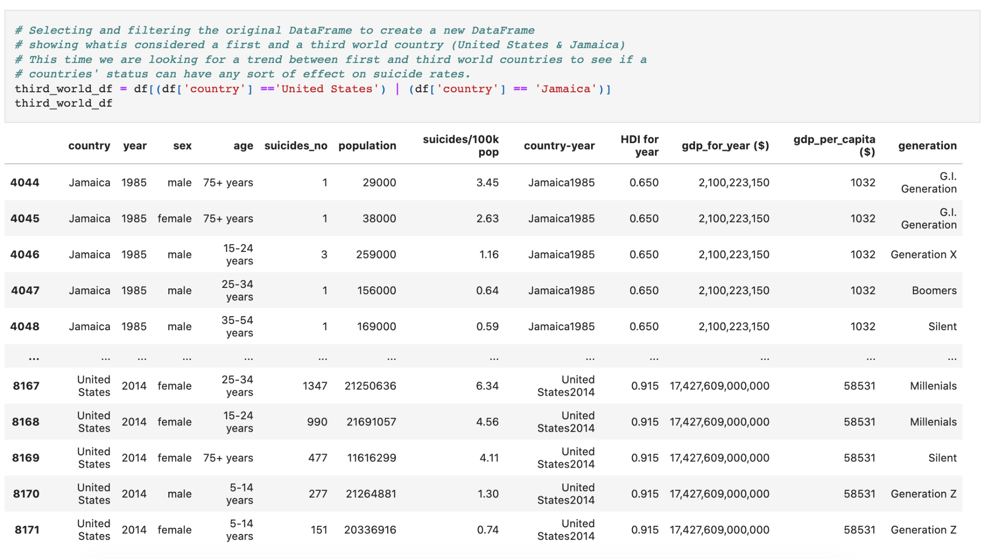
The Data We Used
The dataset we grabbed contained data from around 100 countries around the world.
We wanted to look for possible trends that can lead to suicide while also taking socioeconomic status into consideration to see if the model can create accurate predictions.
We decided to make one dataframe comparing two first world countries (Uk & USA) as well as a first and third world country ( USA & Jamaica) to grab both extremes of the economic spectrum.

Slide 6
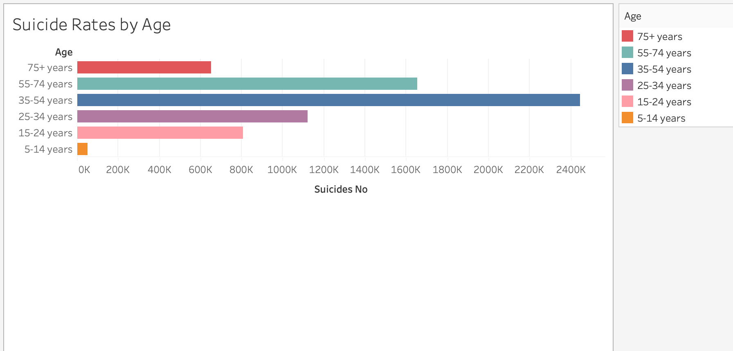
Are younger generations more susceptible to mental health problems and suicide?
When we were creating the questions we created hypothesis of what we thought the answer would be. For this questions we assumed more suicide would be in people 30 or below. Through analyzing the data we discovered that in fact 34-54 year olds are more susceptible to suicides over any other age group.
Capstone Project | Rutgers Bootcamp |Group 4|Rosie, Christian, Valeria| Non - Confidential

Slide 7
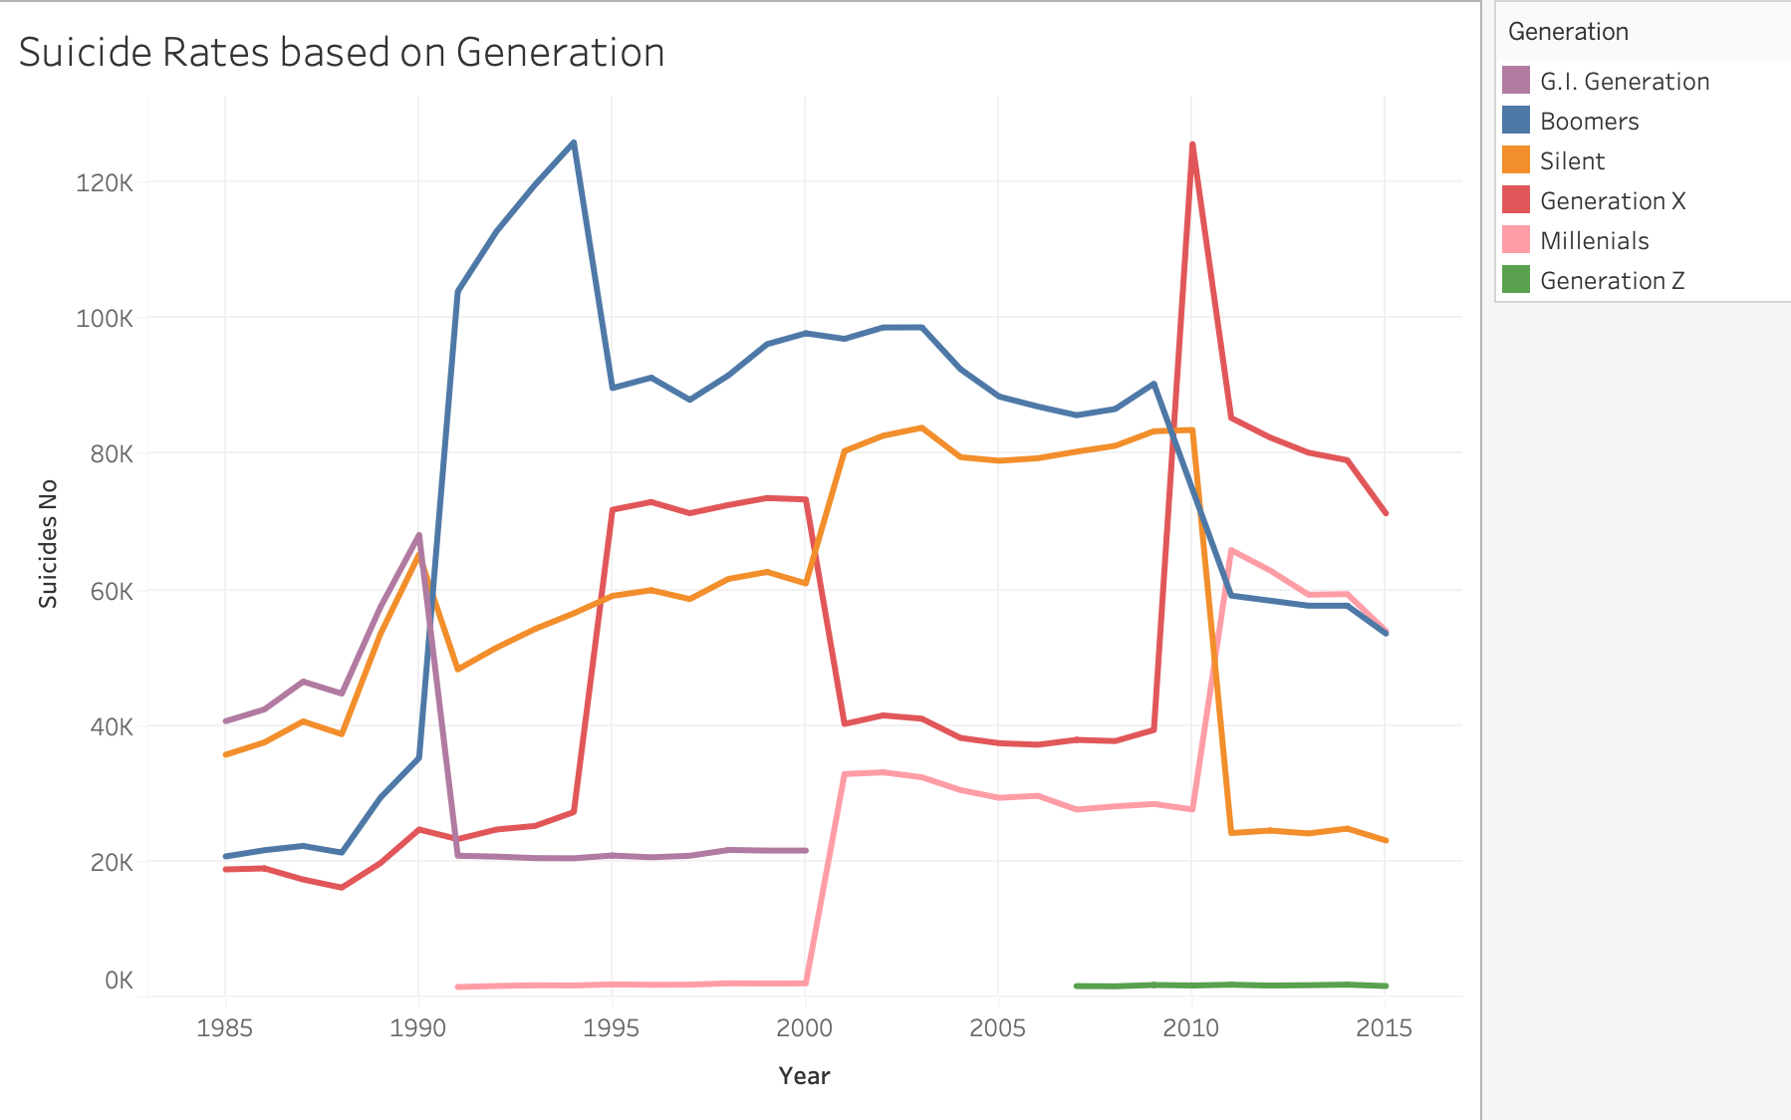
Suicide rates based on generations:
As we can see on the graph different generations had spikes of suicides along the years. One that particularly stood out to us was that Gen x had a massive spike in suicides between the year 2008 and 2012.
This caught our attention because gen x was the most affected by the housing crisis. Many families were put in trying positions and we’re sure that mental health was in crisis as well during that time.
But overall it appears to us suicide rates seem to be decreasing. with all generations.
Capstone Project | Rutgers Bootcamp |Group 4|Rosie, Christian, Valeria| Non - Confidential

Slide 8
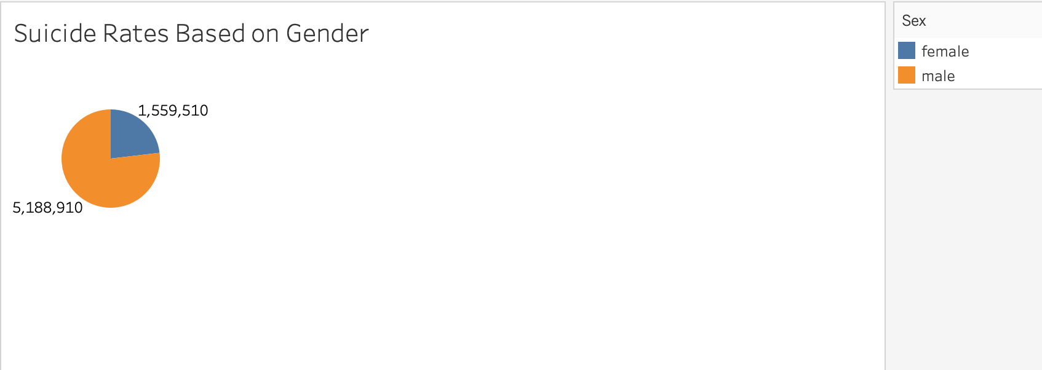
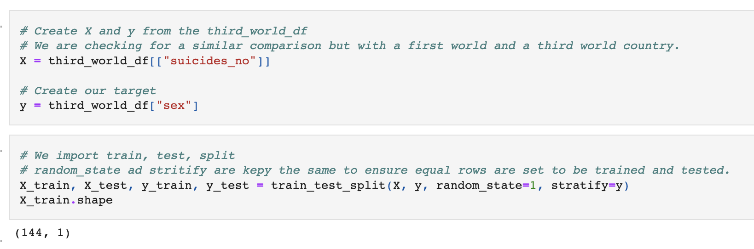
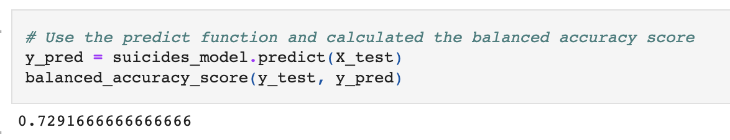
Which sex is committing suicide at a higher rate worldwide?
Our analysis has shown that men commit suicide worldwide at a higher rate than women. This number is not just a slight difference, it is staggering.
Mental health might not be just a men problem but due to societal pressures and stereotypes less men seek help when struggling with mental health.
Less men go to therapy, less men use anti depression medication, and more men feel the need to internalize their problems. All these factors lead to men having a high rate on suicide. About 70% of all suicide were men.
In addition, our machine learning model was able to predict the gender of the individuals in the dataset around 73% of the time despite them being from two different countries with different socioeconomic backgrounds.
Capstone Project | Rutgers Bootcamp |Group 4|Rosie, Christian, Valeria| Non - Confidential

Slide 9
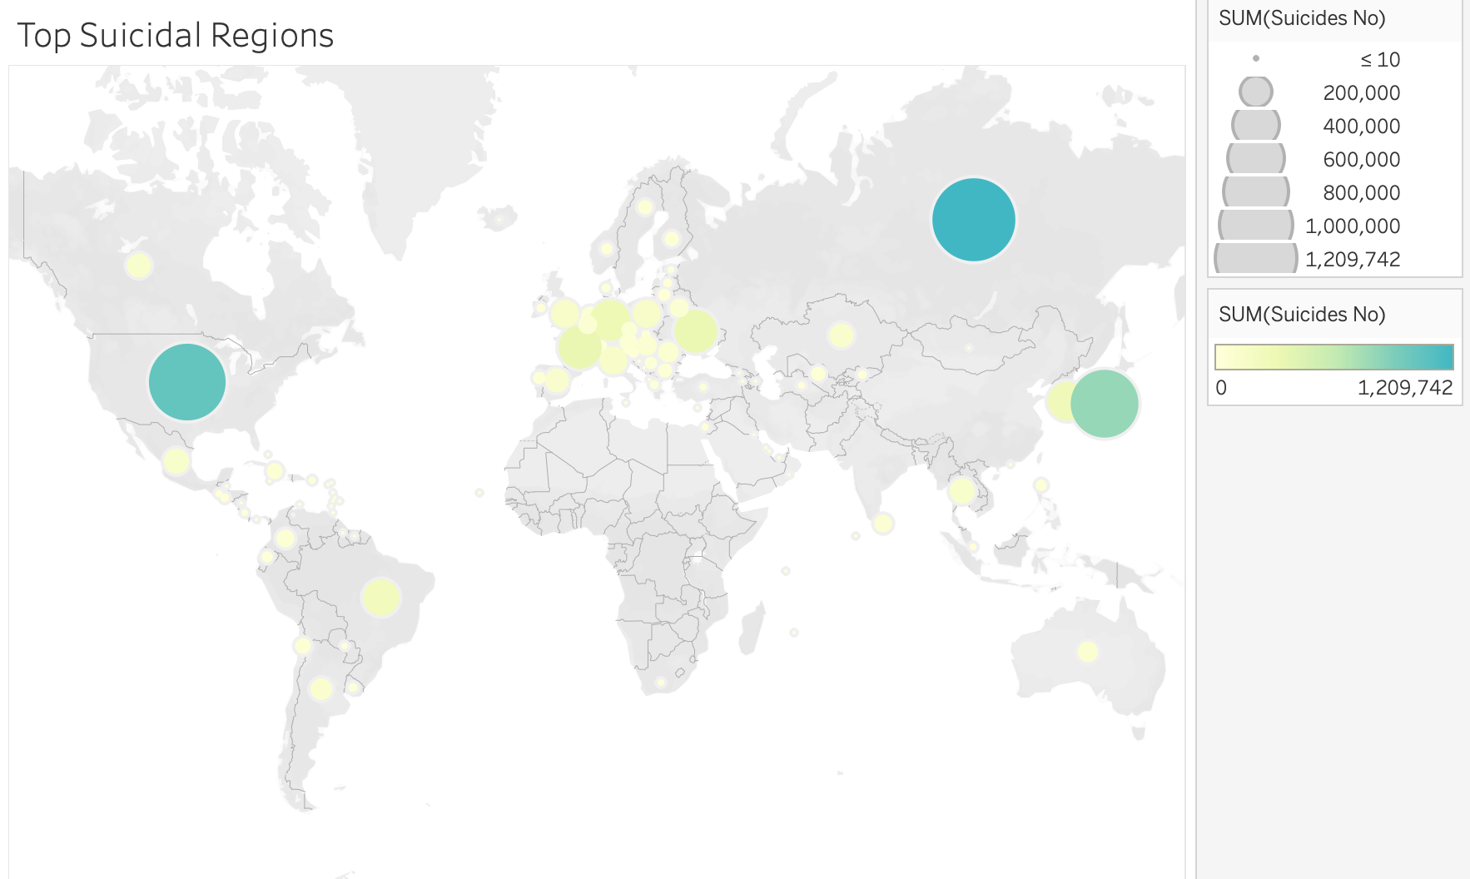
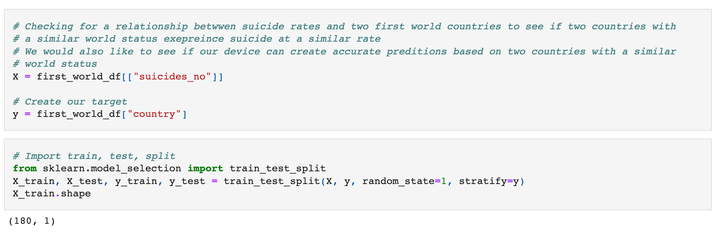
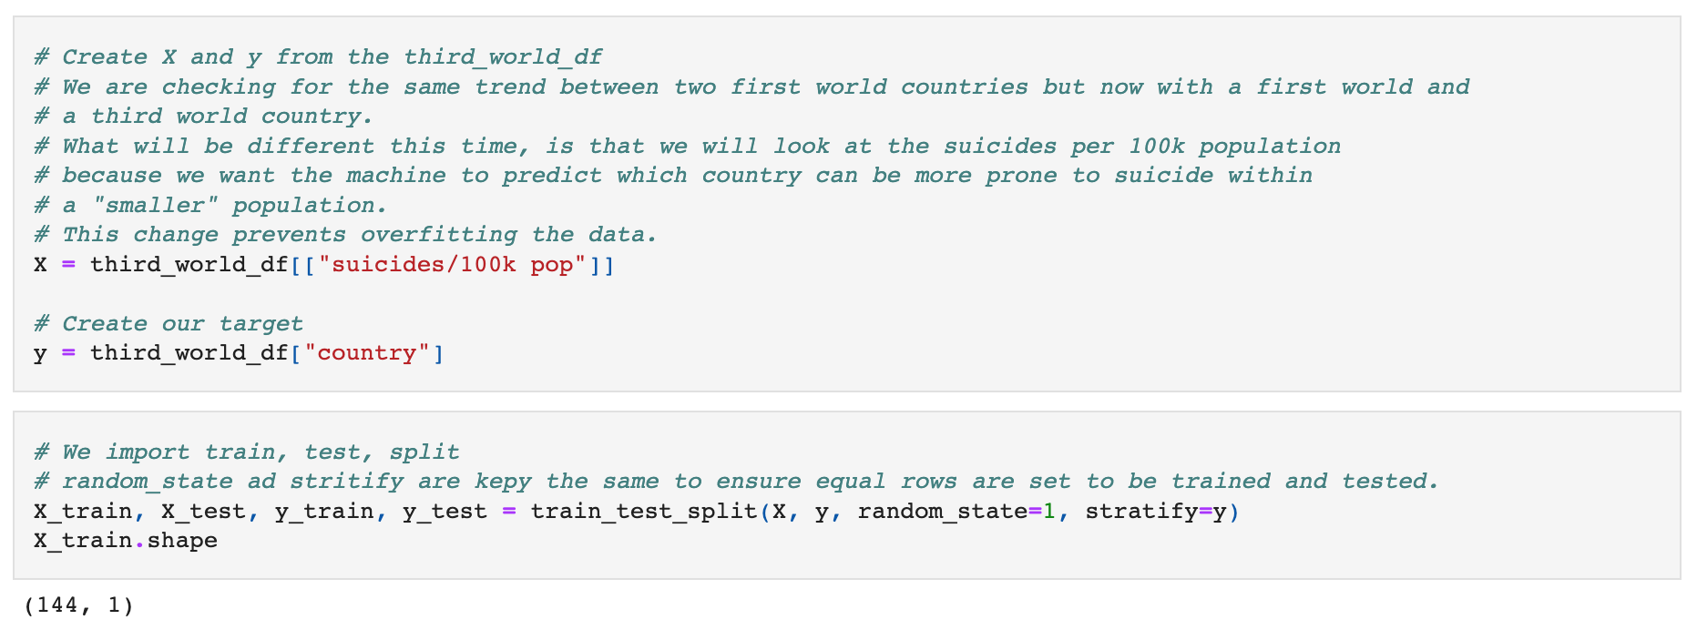
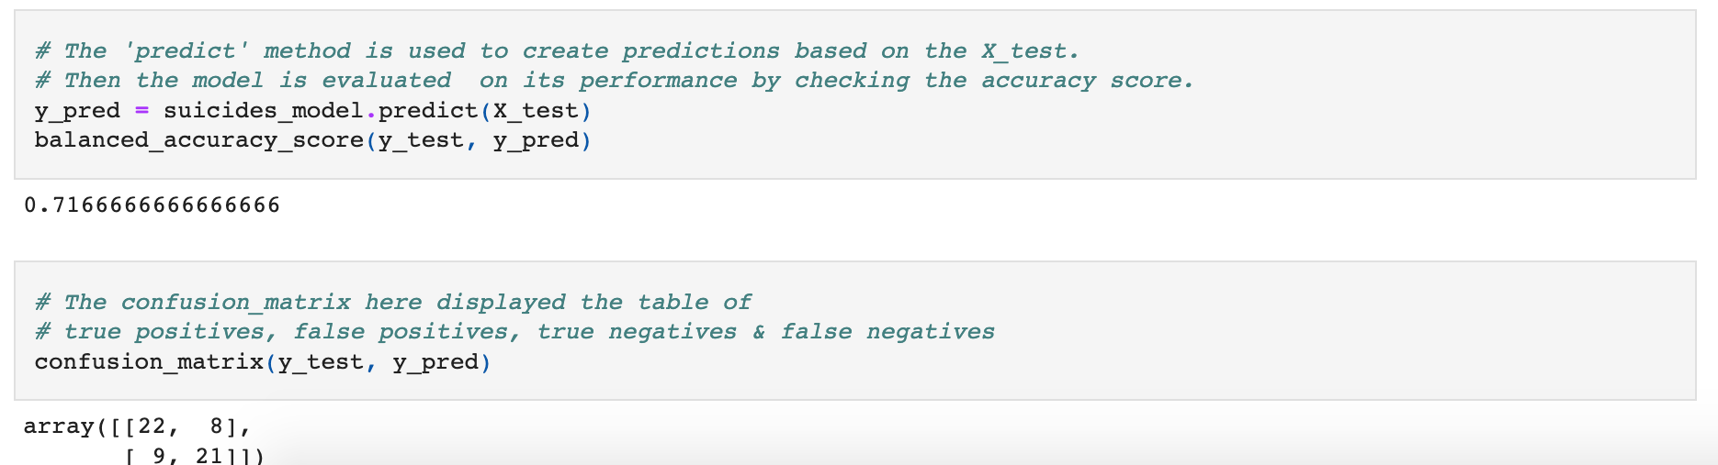
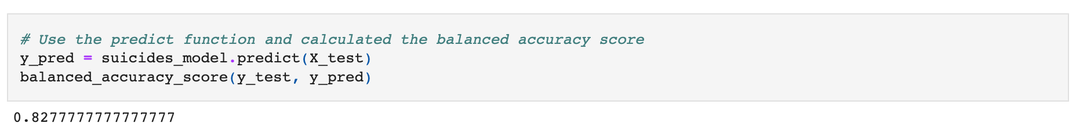
Which regions of the world are commuting suicide at a higher rate?
During our analysis of the data we uncovered that 1st world countries had more suicides per capita than anywhere else in the world. Our conclusion for the reasoning came to the reporting of the suicides and the other leading causes of death in those countries due to lack of resources.
When running our model, we wanted to see if our machine can differentiate between the rates across countries with different socioeconomic statuses.
Capstone Project | Rutgers Bootcamp |Group 4|Rosie, Christian, Valeria| Non - Confidential

Slide 10
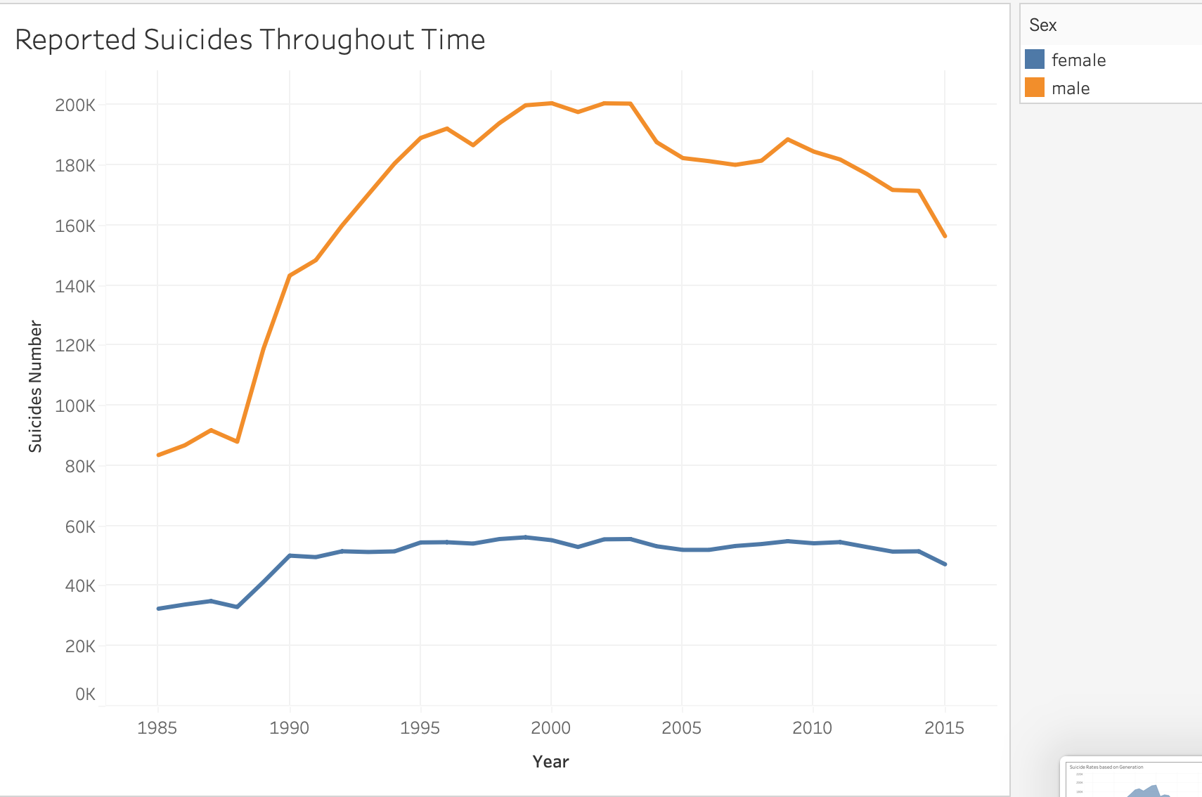
Over the years has suicides and bad mental health become a silent pandemic?
This graph shows the suicide rates throughout time for males and females. What we noticed is that men have exponentially increased while women have stayed about the same.
Our Dashboard: https://public.tableau.com/app/profile/christian4489/viz/Suicide_Regions-Tableau/SuicideRatesDashboard?publish=yes
Capstone Project | Rutgers Bootcamp |Group 4|Rosie, Christian, Valeria| Non - Confidential

Slide 11
“Bloopers”
While working on the machine learning model, we came across some aspects of the code which caused our scores to vary drastically
Through collaboration and edits made to the code, we were able to fix these mistakes which improved our code substantially.
Through these edits, we also discussed how important it is to understand why our code came out the way it did the first time.
Capstone Project | Rutgers Bootcamp |Group 4|Rosie, Christian, Valeria| Non - Confidential

Slide 12
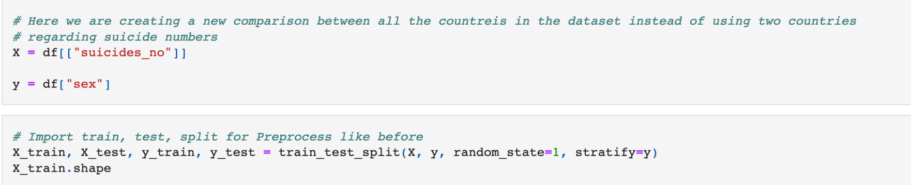
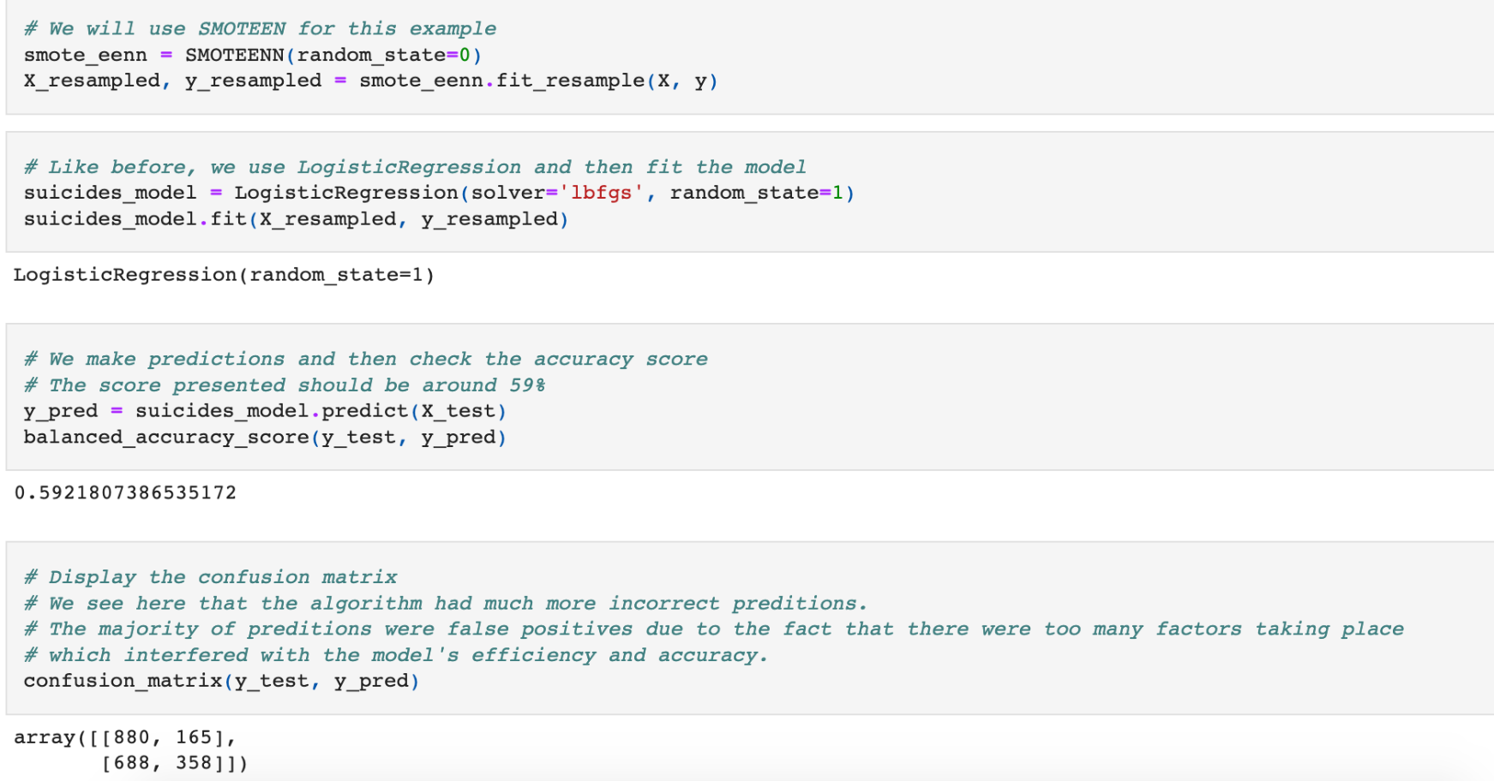
“Bloopers” (Low Accuracy Score)
In the code here, we can see that in our comparison of suicide rates and gender come to a very low score. (around 59% accuracy)
When looking at the confusion matrix, we can see that the majority of the wrong predictions were False Positives
When observing the code, we believe the reason on why the score was so low is because our algorithms were making predictions that came from way to many other factors in our dataset.
In this case the amount of countries for the whale dataset were taken into account causing the machine to have a hard time
To counter this, we decided to take out some factors that interfered with the score itself
Capstone Project | Rutgers Bootcamp |Group 4|Rosie, Christian, Valeria| Non - Confidential

Slide 13
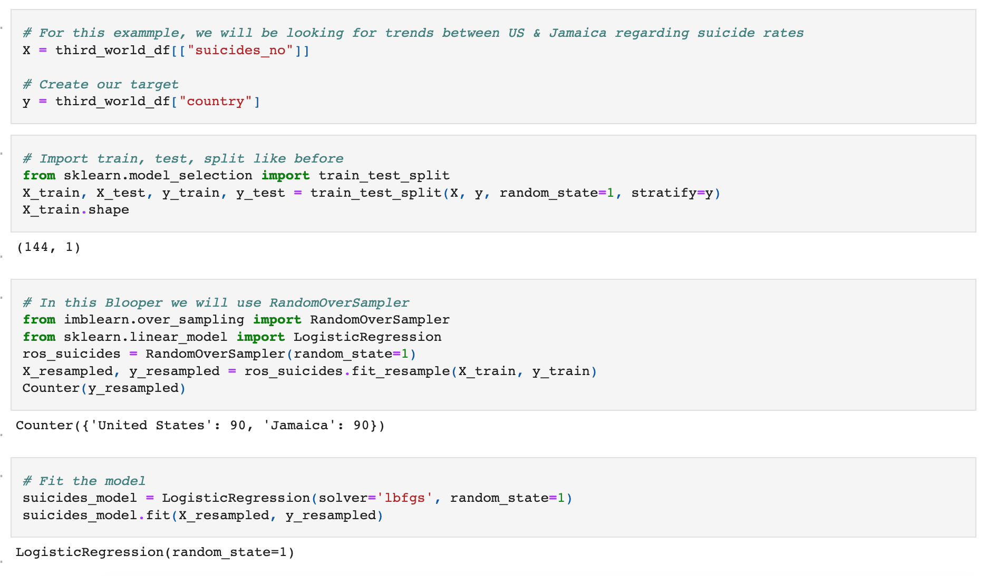
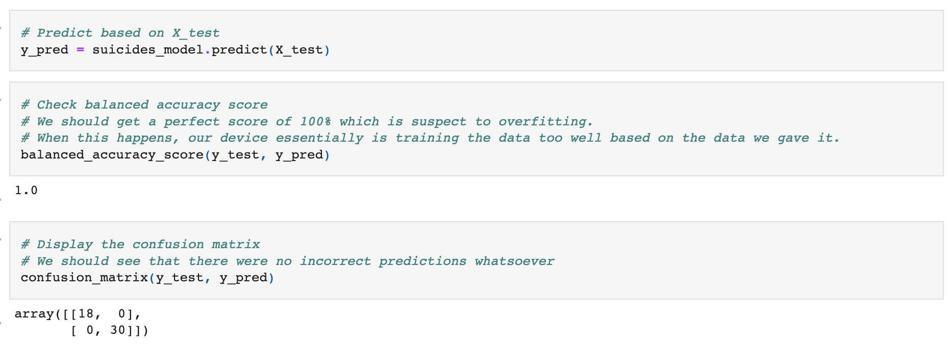
“Bloopers” (Overfitting)
Along with receiving low accuracy scores in some of our algorithms, there were instances where a perfect score was reached.
Based on what we learned, a perfect score meant that there was a case of overfitting we had to look at.
In our code, we realized that our model was having a way too easy of a time making predictions
In order to fix this, we created a new algorithm with a new independent variable (X = “suicides/100k pop”)
Capstone Project | Rutgers Bootcamp |Group 4|Rosie, Christian, Valeria| Non - Confidential

Slide 14
Benefits and Limitations of a Supervised Machine Learning Model (and the algorithms)
Benefits:
We have full control over what we can make our machine learn
When using a supervised learning model, we already have the "answers" we need in the form of labels.
It was our job to produce data output of the labels in the form of graphs and algorithms
The process of using the algorithms was very streamlined.
This includes testing and debugging the algorithms and the machine
Limitations:
In order to get the best results, we need to make good comparisons when it comes to coding itself.
This is made apparent when there are too many factors in the dataset for the model to make the best predictions. This in turn causes some of the algorithms predictions and accuracy to be lower than we had hoped.
Looking for trends when there is too much “noise” can cause lower scores, especially with a large amount of data
Capstone Project | Rutgers Bootcamp |Group 4|Rosie, Christian, Valeria| Non - Confidential

Slide 15
Resources
Suicide Rates Overview 1985 to 2016
Uploaded by “Rusty” from Kaggle
Extra Resources used for this Dataset:
United Nations Development Program. (2018). Human development index (HDI). Retrieved from http://hdr.undp.org/en/indicators/137506
World Bank. (2018). World development indicators: GDP (current US$) by country:1985 to 2016. Retrieved from http://databank.worldbank.org/data/source/world-development-indicators#
[Szamil]. (2017). Suicide in the Twenty-First Century [dataset]. Retrieved from https://www.kaggle.com/szamil/suicide-in-the-twenty-first-century/notebook
World Health Organization. (2018). Suicide prevention. Retrieved from http://www.who.int/mental_health/suicide-prevention/en/
Jupyter Notebook
Kernel: mnlev
Model: Supervised Learning Model
Tableau
GitHub
Capstone Project | Rutgers Bootcamp |Group 4|Rosie, Christian, Valeria| Non - Confidential

Slide 16
Thank You!
We Welcome Questions

